Slide 1
Greenplum Workshop
PLContainer - Trusting Untrusted Languages

Slide 2
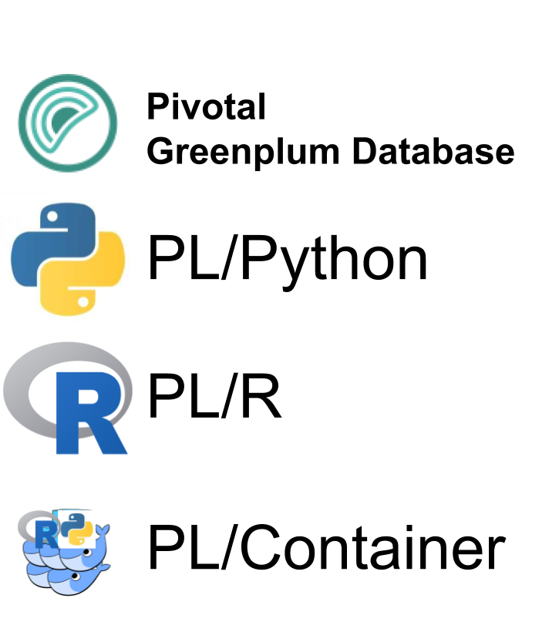
Agenda
The Problem
What is PL/Container
How to use PL/Container
PL/Container Internals
Future Work
Q+A

Slide 3
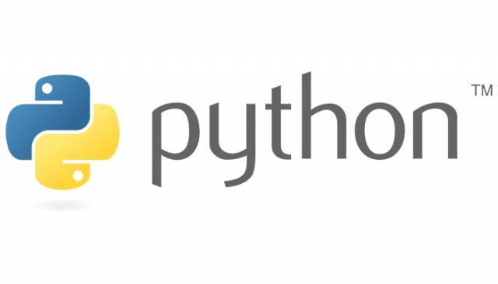







We want to analyse data IN Database

Slide 4
BUT …
PL/Python and PL/R are UNTRUSTED Languages

Slide 5


Only Superuser can Create UDF in Untrusted Languages
System(“rm -rf /data”)

Slide 6


The Problem: Triangle Dependency
Data Scientist
Run UDF
UDF
Package
Package
UDF
1. Greenplum
Review & Create
2. Operation System
3. Python / R
Greenplum
DBA
4. TensorFlow

Slide 7
What is PL/Container?
PL/Container is a customizable, secure runtime for Greenplum Database Procedural Languages.
Greenplum Database Extension
Stateless
Based on Docker Container
Customizable
Secure
Isolated
PL/Container
PL/Container

Slide 8
PL/Container Architecture
1. Query plan
12. Result
Repeat p.12
GPDB Segment host
2. Parse container name from UDF body
Query Executor
Repeat p.8 – p.11
6. Ping
7. Ping
8.Call
9. SPI
10. Result
3. Read configuration
11. Result
Config.xml
Container
Embedded Python
4. Bring up container
5. Start
Docker

Slide 9
How UDF run in PL/Container?
PL/Container is a customizable, secure runtime for Greenplum Database Procedural Languages.
PL/Container Extension starts a docker container (only in 1st call)
Transfer UDF and data to docker container
Run the UDF in docker container
Contact the docker container to get the results
PL/Container
PL/Container

Slide 10
Install PL/Container on Greenplum
Install from Source Code
source $GPHOME/greenplum_path.sh
make install
Install from GPPKG
gppkg –i plcontianer-1.1.0-rhel7-x86_64.gppkg
no additional dependencies
Prerequisites
Platform
Centos 6.6+ or 7.x
Database
Greenplum 5.2+
Docker
Docker 17.05+ on Centos7
Docker 1.7+ on Centos6

Slide 11
Build Custom Docker Image (optional)
Minimum Requirement:
Python or R environment
Add location of libpython.so and libR.so to LD_LIBRARY_PATH
Customize Your image:
Install specific packages
FROM continuumio/anaconda
ENV LD_LIBRARY_PATH "/opt/conda/lib:$LD_LIBRARY_PATH”
FROM continuumio/anaconda3
RUN conda install -c conda-forge -y tensorflow
ENV LD_LIBRARY_PATH "/opt/conda/lib:/usr/local/lib:$LD_LIBRARY_PATH"

Slide 12
Configure PL/Container
XML
Image
Runtime
runtime
<id>
<image>
<command>
<shared directory>
<setting memory_mb>
<setting cpu_share>
image add
image delete
image list
runtime add
runtime delete
runtime backup
runtime restore
runtime edit
runtime show
container cgroup node
memory.memsw.limit_in_bytes
cpu.shares
Notes:
After you install PLContainer, you need to configure the PLContainer environment first.

Slide 13
Run PL/Container
Running a simple plpython UDF to calculate log₁₀
postgres=# CREATE LANGUAGE plpythonu;
postgres=# CREATE OR REPLACE FUNCTION pylog10(input double precision) RETURNS double
precision AS $$
import math
return math.log10(input)
$$ LANGUAGE plpythonu;
postgres=# SELECT pylog10(100);
pylog10
--------------
2
(1 row)

Slide 14
Run PL/Container
Running a simple PL/Container UDF to calculate log₁₀
postgres=# CREATE EXTENSION plcontainer;
postgres=# CREATE OR REPLACE FUNCTION pylog10(Input double precision) RETURNS double
precision AS $$
# container: plc_python_shared
import math
return math.log10(input)
$$ LANGUAGE plcontainer;
postgres=# SELECT pylog10(100);
pylog10
--------------
2
(1 row)

Slide 15
Performance
Test Environment
Hardware: 6 virtual machines, each with 19G memory and 5 processors. (Intel(R) Xeon(R) CPU E5-2697 v2 @ 2.70GHz)
Software: Centos7, GPDB 5.2 with 30 segments.
Workloads
Long-running function
Large input array function
Large output array function

Slide 16
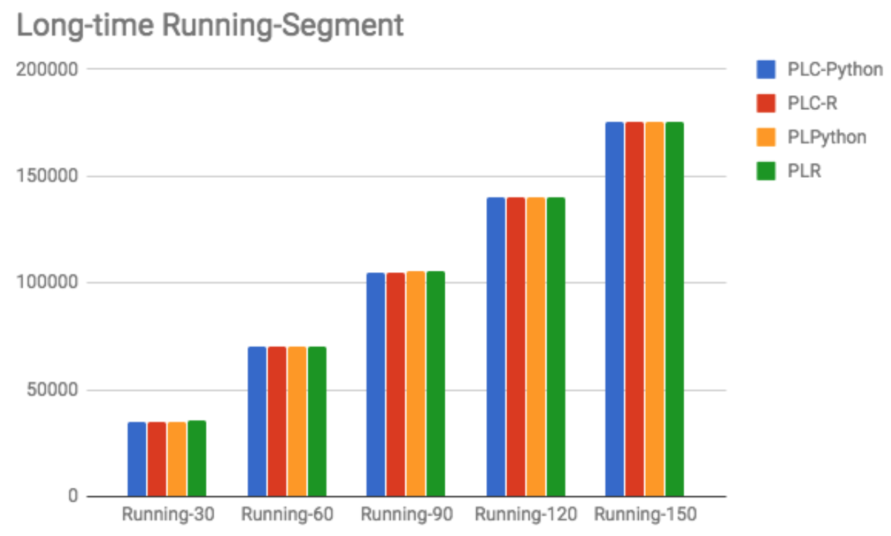
Performance
Long-running function
CREATE OR REPLACE FUNCTION pysleep(i int) RETURNS void AS $$
# contaziner: plc_python_shared
import time
time.sleep(i)
$$ LANGUAGE plcontainer;
SELECT count(pysleep(1)) FROM tbl;
no performance downgrade

Slide 17

Transforming How The World Builds Software
© Copyright 2017 Pivotal Software, Inc. All rights Reserved.

